Slide 1


Capewell Solid-State Timer
Team 9:
Patrick Dunham
Joshua Reinert
Faculty Advisor: Dr. Thanh Nyugen
Sponsor Representative: Andrew Smith

Slide 2



About Capewell
Founded 1881 - Capewell Horse Nail Company
1939 - Military Parachute Hardware
2000 - Capewell Acquires Marktime/MH Rhodes
Notes:
Brief history summary, mention Marktime acquisition. Marktime makes timers (cycle timers, household timers, sensor switches, etc.). Employees = ??? Scale of production = ???

Slide 3
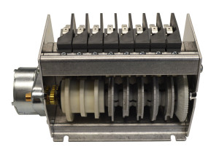
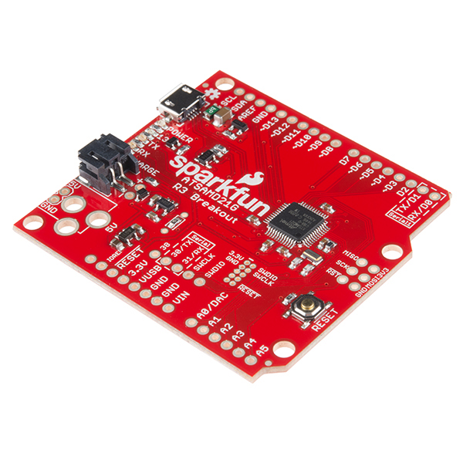
Project Statement
Redesign current C10/C11 Cycle Timer
Currently electromechanical
Will be completely solid-state
Goals:
Inexpensive (~$40 Parts)
Reliable (500k+ Cycles)
Drop-in Replacement
Notes:
Just read our project statement…. Mention what we’re doing, mention the requirements. See project statement for reference. (Must be at least 2-layer PCB)

Slide 4
Approach
Research Components
TRIACs, SCRs, Relays…
Power Supplies
User Interfaces
Test Circuit
Verify circuit operation
Verify PCB design
Measure component temperatures
Compare to PSPICE model predictions
Design Enclosure
Protect sensitive electronics
Match current enclosure footprint
Manage heat dissipation

Slide 5
Team Organization
5 Components + System Management:
Enclosure - Joshua Reinert
Relays - Jaileen Algarin [ECE]
Microcontroller - Patrick Dunham
Power Supply - Robert Endrizzi [ECE]
User Interface - Nicole Hershman [ECE]
Systems - Patrick Meres [ECE]
Weekly meetings with faculty advisors
Monthly meetings with corporate sponsor
Google Drive for file-sharing/design notebook
Lab Space in ITE C43
Notes:
NO NDA NO NDA NO NDA

Slide 6


Training
Circuit simulation [PSPICE]
PCB Design [Eagle]
CAD [Fusion 360]

Slide 7
Issues
Nonfunctional PCB
Identify mistake and reorder
Too Much Heat
Use electromechanical relays
Can’t program microcontroller
Use Arduino bootloader
Improper Enclosure Dimensions
Identify mistake and reprint

Slide 8
Schedule

Slide 9
Current Status
ECE lab bench & equipment is functional
Schematics for relay, microcontroller are completed
User Interface, Power Supply ideas identified, research underway
Enclosure footprint defined, waiting on confirmation of heat output
Next steps:
Begin prototyping microcontroller/relay circuits
Create schematic for User Interface, Power Supply
Create CAD model of enclosure
Notes:
5.5” L x 3.25”W x 3” H

Slide 10
Peer Assessment
A - “I get it” - Clear, nice job!
B - “I kind of get it” - Needs more work.
C - “I’m confused” - Needs lots of work.

